Slide 1

Pattern Recognition
Chapter 3: K Nearest Neighbours
Chumphol Bunkhumpornpat
Department of Computer Science
Faculty of Science
Chiang Mai University

Slide 2
Learning Objectives
What a nearest neighbour (NN) algorithm is
The different variants of NN algorithms like
  The k nearest neighbour (kNN) algorithm
  The modified k nearest neighbour (MkNN) algorithm
  The r near algorithm
  The fuzzy KNN algorithm
The different methods of prototype selection used in classification like
  The minimal distance classifier (MDC)

Slide 3
Nearest Neighbour Based Classifiers
Simplest Decision Procedures
Nearest Neighbour (NN) Rule
Similarity between a test pattern and every pattern in a training set
Less than twice the probability of error compared to any other decision rule

Slide 4
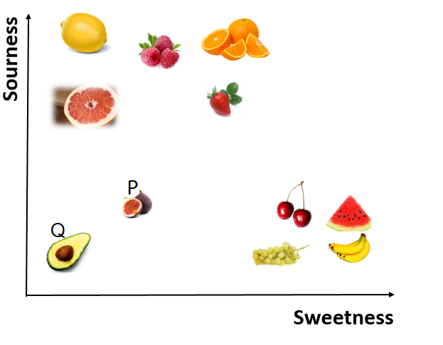

Slide 5
Nearest Neighbour Algorithm
The nearest neighbour algorithm assigns to a test pattern the class label of its closest neighbour.

Slide 6
Let the training set consist of the following three dimensional patterns:
X₁ = (0.8, 0.8, 1), X₂ = (1.0, 1.0, 1), X₃ = (1.2, 0.8, 1)
X₄ = (0.8, 1.2, 1), X₅ = (1.2, 1.2, 1), X₆ = (4.0, 3.0, 2)
X₇ = (3.8, 2.8, 2), X₈ = (4.2, 2.8, 2), X₉ = (3.8, 3.2, 2)
X₁₀ = (4.2, 3.2, 2), X₁₁ = (4.4, 2.8, 2), X₁₂ = (4.4, 3.2, 2)
X₁₃ = (3.2, 0.4, 3), X₁₄ = (3.2, 0.7, 3), X₁₅ = (3.8, 0.5, 3)
X₁₆ = (3.5, 1.0, 3), X₁₇ = (4.0, 1.0, 3), X₁₈ = (4.0, 0.7, 3)

Slide 7
Let the training set consist of the following three dimensional patterns:
(cont.)
Class 1: +
Class 2: X
Class 3: *
P = (3.0, 2.0)
d(X, P) = √(X[1] – P[1])² + (X[2] – P[2])²
d(X₁, P) = √(0.8 – 3.0)² + (0.8 – 2.0)² = 2.51
d(X₁₆, P) = √(3.5 – 3.0)² + (1.0 – 2.0)² = 1.12

Slide 8
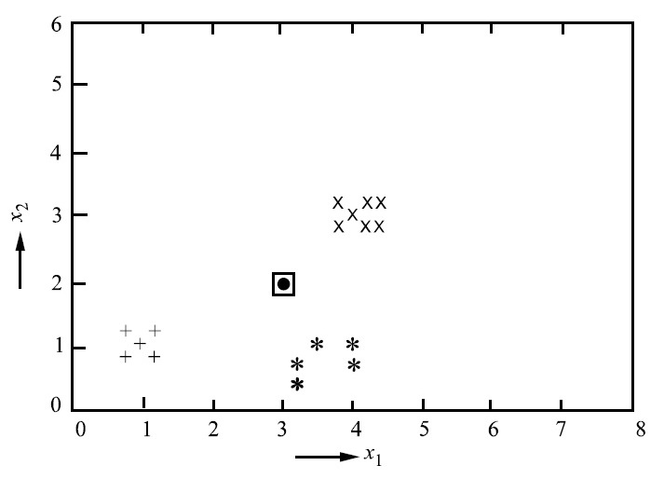
Example Data Set

Slide 9
Variants of the NN Algorithm
k-Nearest Neighbour (kNN) Algorithm
The Modified k Nearest Neighbour (MkNN) Algorithm
The r Near Algorithm

Slide 10
k-Nearest Neighbour (kNN) Algorithm
The majority class of the k nearest neighbours is the class label assigned to the new pattern.
The value chosen for k is crucial.
With the right value of k, the classification accuracy will be better than that got by using the nearest neighbour algorithm.

Slide 11
Example Data Set (k = 5)

Slide 12
k-Nearest Neighbour (kNN) Algorithm (cont.)
It reduces the error in classification when training patterns are noisy.
The closest pattern of the test pattern may belong to another class, but when a number of neighbours are obtained and majority class label is considered, the pattern is more likely to be classified correctly.

Slide 13
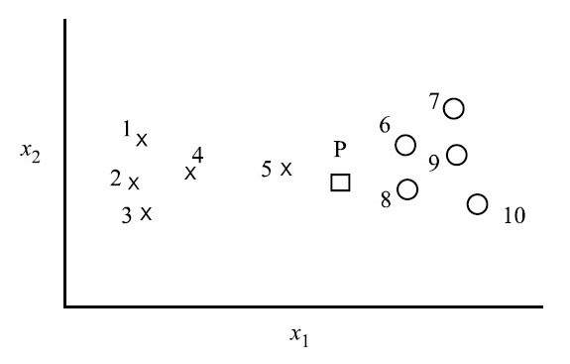
P can be correctly classified using the kNN algorithm.

Slide 14
P can be correctly classified using the kNN algorithm (cont.)
For larger data sets, k can be larger to reduce the error.
k can be determined by experimentation, where a number of patterns taken out from the training set (validation set) can be classified using the remaining training patterns for different values of k.
It can be chosen as the value which gives the least error in classification.

Slide 15
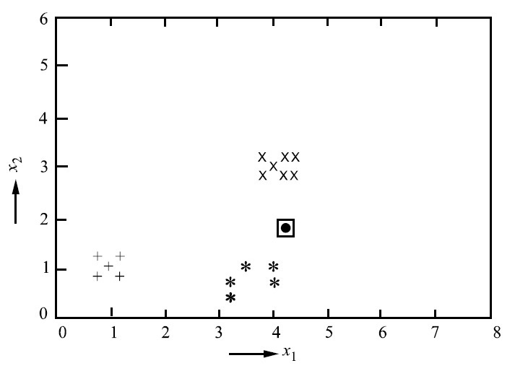
Example Data Set 2 (k = 5)

Slide 16
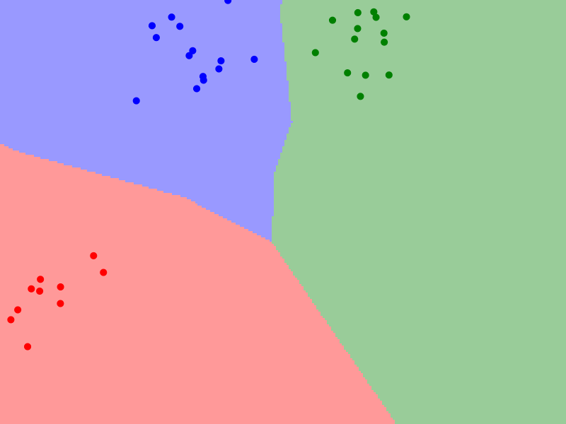
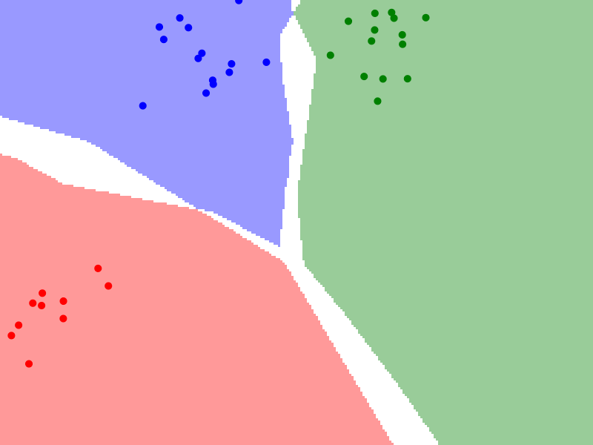
k = 1
k = 2

Slide 17
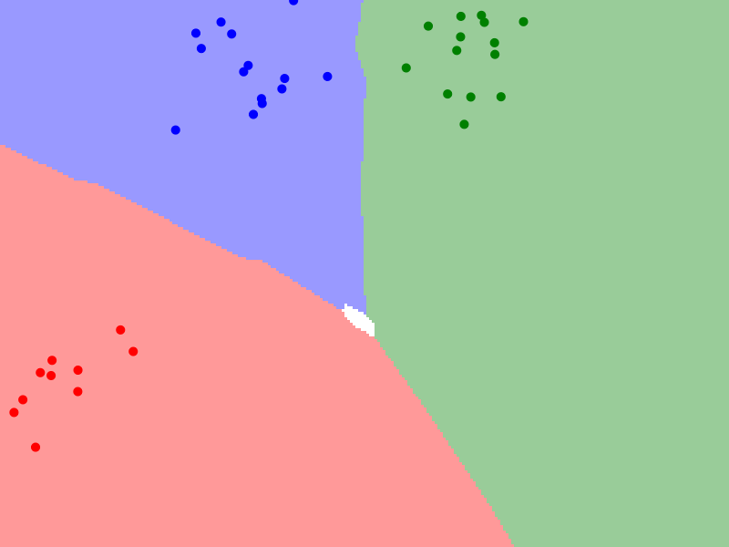
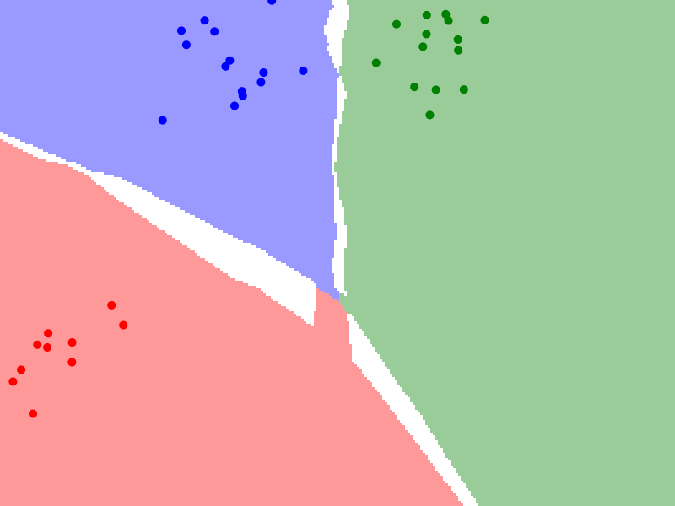
k = 3
k = 4

Slide 18
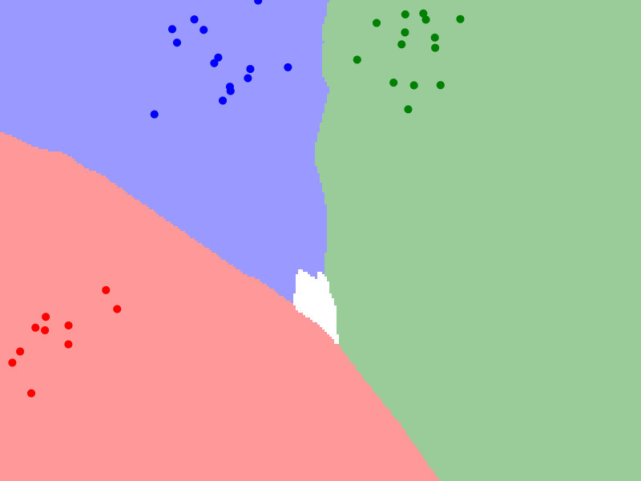
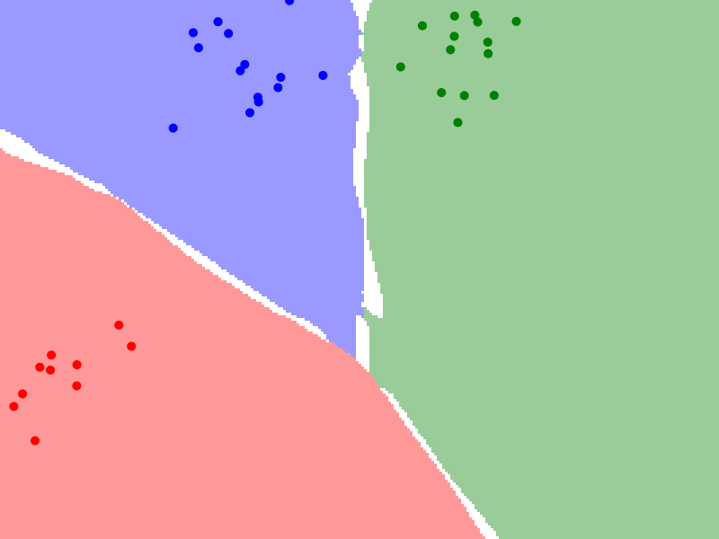
k = 5
k = 6

Slide 19
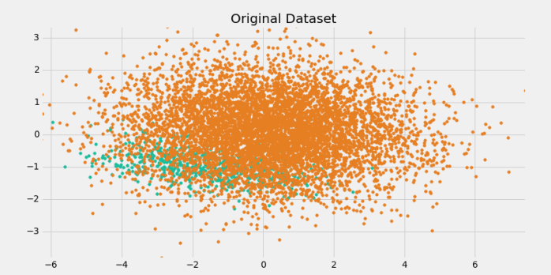
Problem with Class Imbalance

Slide 20
Modified k Nearest Neighbour (MkNN) Algorithm
The Distance-Weighted k-Nearest Neighbour Algorithm
k Nearest Neighbours are weighted according to the distance from the test point.

Slide 21
Modified k Nearest Neighbour (MkNN) Algorithm (cont.)
w_{j} = (d_{k} – d_{j}) / (d_{k} – d₁) if d_{k} ≠ d₁
1 if d_{k} = d₁
j = 1, …, k
w_{j} varies from a maximum of 1 for the nearest neighbour down to a minimum of 0 for the most distant.

Slide 22
Modified k Nearest Neighbour (MkNN) Algorithm (cont.)
It assigns the test pattern P to that class for which the weights of the representatives among the k nearest neighbours sums to the greatest value.
It employs a weighted majority rule.
The outlier patterns have lesser effect on classification.

Slide 23
Example Data Set (k = 5)

Slide 24
Example Data Set (k = 5) (cont.)
d(P, X₁₆) = 1.12
d(P, X₇) = 1.13
d(P, X₁₄) = 1.32
d(P, X₆) = 1.41
d(P, X₁₇) = 1.41

Slide 25
Example Data Set (k = 5) (cont.)
w₁₆ = 1
w₇ = (1.41 – 1.13) / (1.41 – 1.12) = 0.97
w₁₄ = (1.41 – 1.32) / (1.41 – 1.12) = 0.31
w₆ = 0
w₁₇ = 0

Slide 26
Example Data Set (k = 5) (cont.)
Class 1 sums to 0
Class 2 to which X₇ and X₆ belong sums to 0.97.
Class 3 to which X₁₆, X₁₄ and X₁₇ belong sums to 1.31.
The point P belongs to Class 3.
kNN and MkNN assign the same pattern a same class label.

Slide 27
Example Data Set 2 (k = 5)

Slide 28
Example Data Set 2 (k = 5)
d(P, X₁₇) = 0.83
d(P, X₈) = 1.00
d(P, X₁₁) = 1.02
d(P, X₁₆) = 1.06
d(P, X₇) = 1.08

Slide 29
Example Data Set 2 (k = 5) (cont.)
w₁₇ = 1
w₈ = (1.08 – 1.00) / (1.08 – 0.83) = 0.32
w₁₁ = (1.08 – 1.02) / (1.08 – 0.83) = 0.24
w₁₆ = (1.08 – 1.06) / (1.08 – 0.83) = 0.08
w₇ = 0

Slide 30
Example Data Set 2 (k = 5) (cont.)
Class 1 sums to 0
Class 2 to which X₈, X₁₁ and X₇ belong sums to 0.56.
Class 3 to which X₁₇ and X₁₆ belong sums to 1.08.
The point P belongs to Class 3.
kNN and MkNN assign the same pattern different class labels.

Slide 31
r Near Neighbours (rNN)
All neighbours within some distance r of the point of interest
They ignore very far away nearest neighbour
They identify outlier.

Slide 32
r Near Neighbours (rNN) (cont.)
Outlier
  A pattern does not have any similarity with the patterns within the radius chosen.
Radius r
  Crucial

Slide 33
rNN Algorithm
STEP 1: Given the point P, determine the sub-set of data that lies in the ball of radius r centred at P
B_{r}(P) = {X_{i} ∈ X s.t. ||P – X_{i}|| ≤ r}
STEP 2: If B_{r}(P) is empty, then output the majority class of the entire data set.
STEP 3: If B_{r}(P) is not empty, output the majority class of the data points in it.

Slide 34
Example Data Set (r = 1.45)

Slide 35
Fuzzy KNN
Elements have a degree of membership.
In fuzzy sets, the elements of the set have a membership function attached to them which is in the real unit interval [0, 1].
μ_{ij} gives the membership in the i^{th} class of the j^{th} vector of the training set.

Slide 36
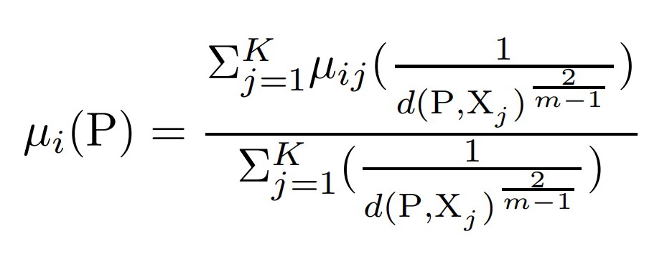
Fuzzy KNN (cont.)

Slide 37
Finding k NNs
X₁ = (0.8, 0.8, 1), X₂ = (1.0, 1.0, 1), X₃ = (1.2, 0.8, 1)
X₄ = (0.8, 1.2, 1), X₅ = (1.2, 1.2, 1), X₆ = (4.0, 3.0, 2)
X₇ = (3.8, 2.8, 2), X₈ = (4.2, 2.8, 2), X₉ = (3.8, 3.2, 2)
X₁₀ = (4.2, 3.2, 2), X₁₁ = (4.4, 2.8, 2), X₁₂ = (4.4, 3.2, 2)
X₁₃ = (3.2, 0.4, 3), X₁₄ = (3.2, 0.7, 3), X₁₅ = (3.8, 0.5, 3)
X₁₆ = (3.5, 1.0, 3), X₁₇ = (4.0, 1.0, 3), X₁₈ = (4.0, 0.7, 3)
P = (3.0, 2.0) ; k = 5 ; m = 2

Slide 38
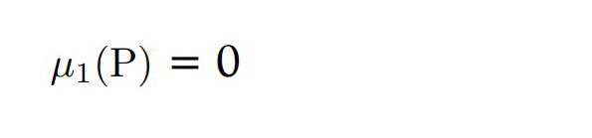
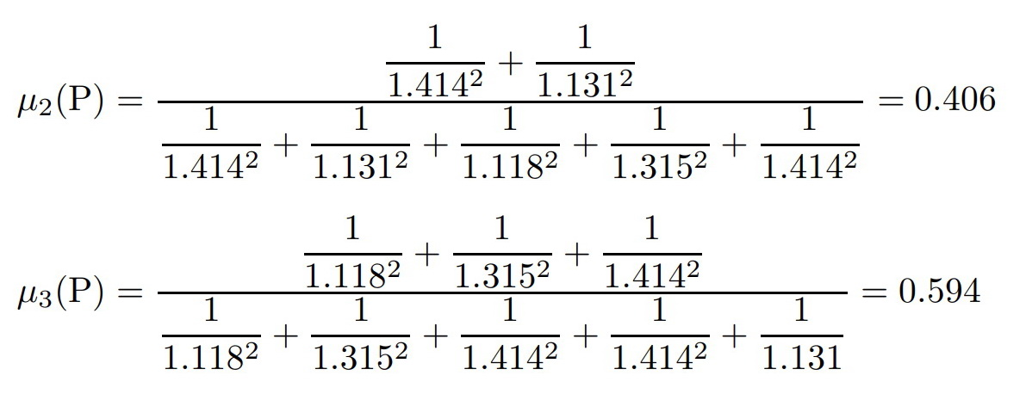
Fuzzy KNN (cont.)

Slide 39
Prototype Selection
Prototype: Sample which would represent or be a typical sample for a large number of samples in the set
  Centroid
  Medoid
Process of reducing the training set used for classification

Slide 40
  Minimal Distance Classifier (MDC)
Each class is represented by the sample mean or centroid of all samples in the class.
C_{i} = ∑^{N}_{j=1} X_{ij} / N
X_{i1}, X_{i2}, …, X_{iN}: N training patterns for the class i
If C_{k} is the centroid closest to P, it is assigned the class label k of which C_{k} is the representative pattern.

Slide 41
MDC (cont.)
n: The number of train patterns
m: The number of test patterns
C: The number of classes
MDC: O(n + mC)
  O(n): Time required for computing the centroid
  O(mC): Time required to search for the nearest centroid of test patterns
NN: O(mn)
Large-Scale Applications: C << n

Slide 42
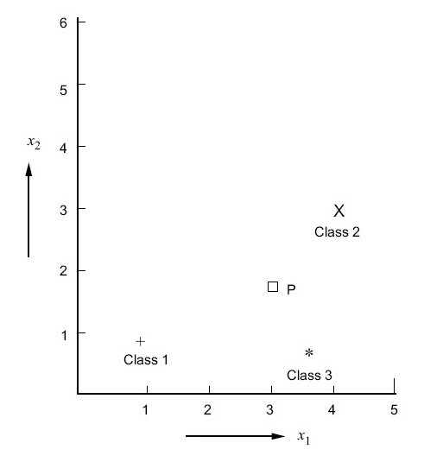
Classification Using MDC

Slide 43
Centroid
Class 1: (1.00, 1.00)
Class 2: (4.11, 3.00)
Class 3: (3.62, 0.72)

Slide 44
Classification Using MDC (cont.)
From P to the centroid of Class 1, the distance is 2.24.
From P to the centroid of Class 2, the distance is 1.49.
From P to the centroid of Class 3, the distance is 1.42.

Slide 45
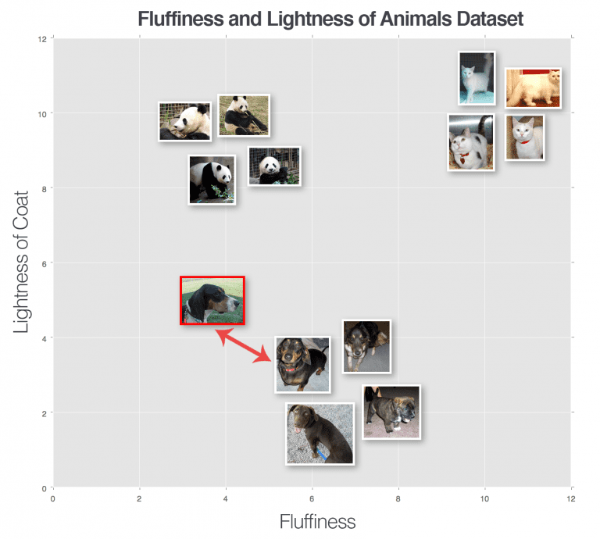
Image Classification

Slide 46
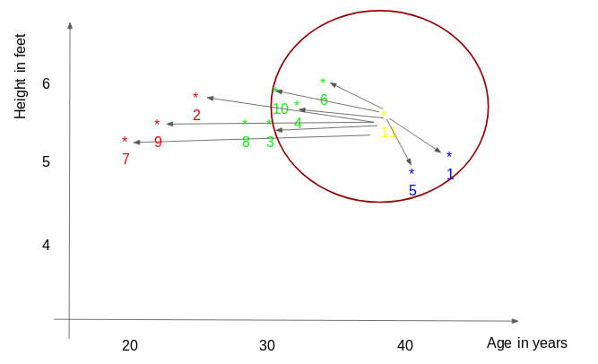

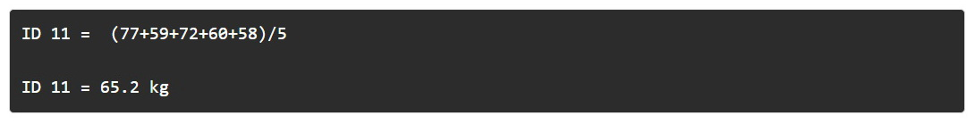
KNN Regression

Slide 47
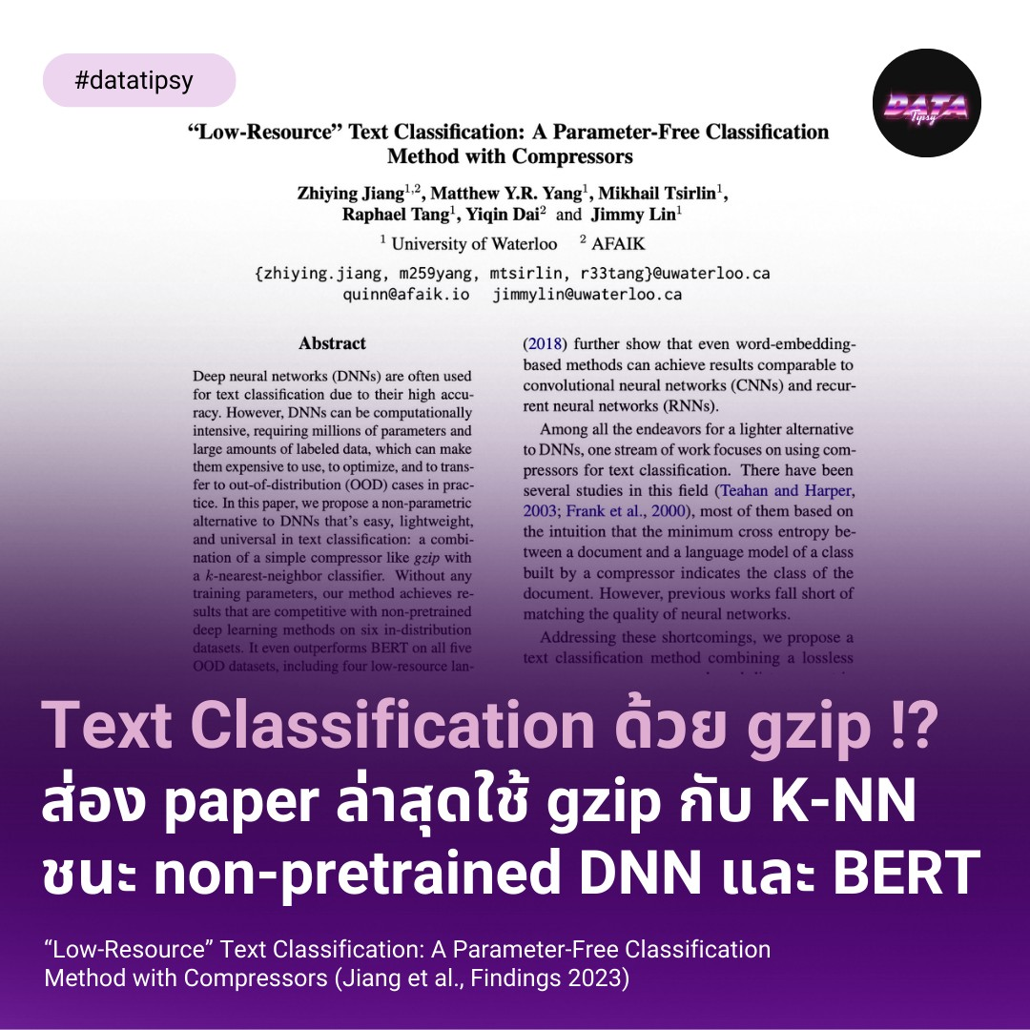

Slide 48
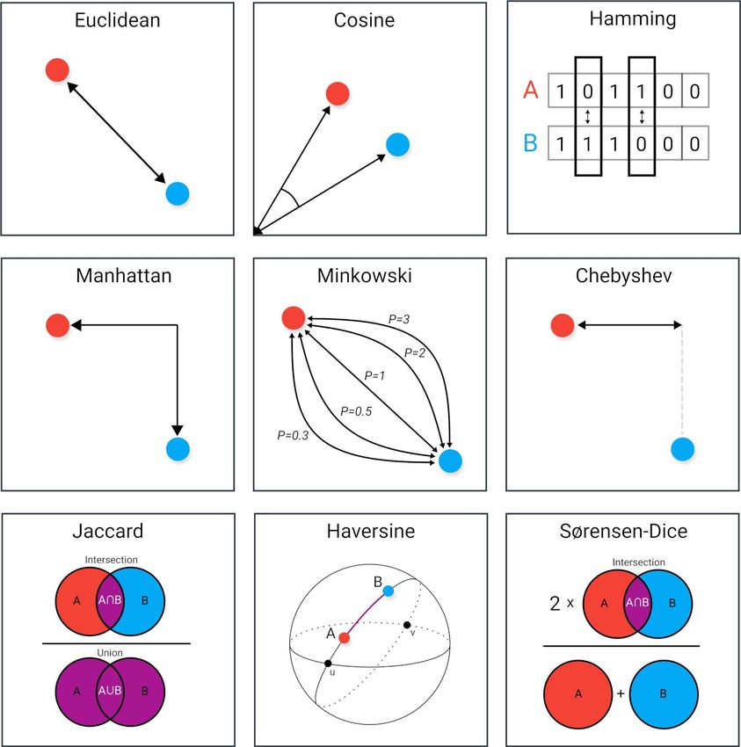


Slide 49
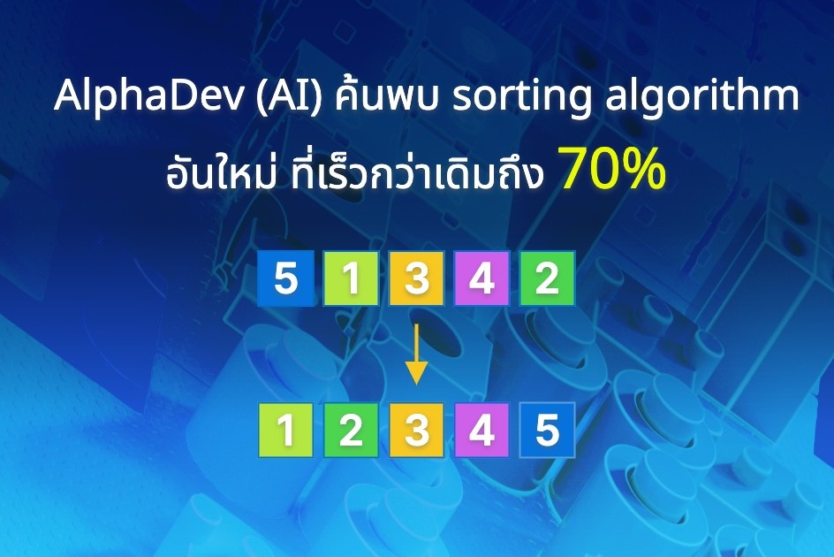


Slide 50
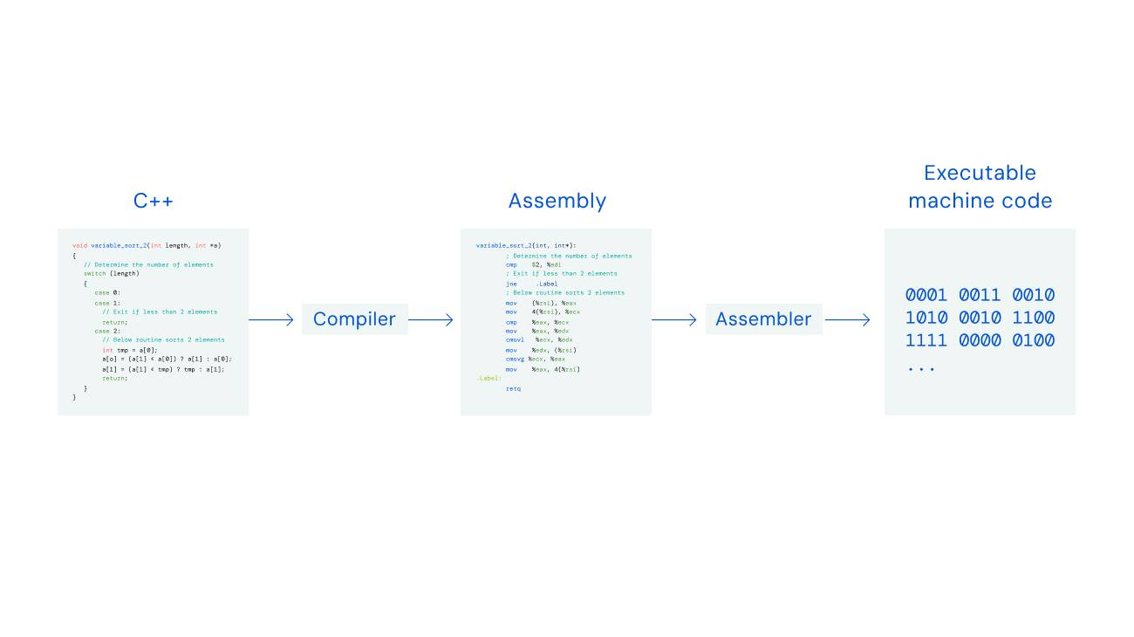

Slide 51
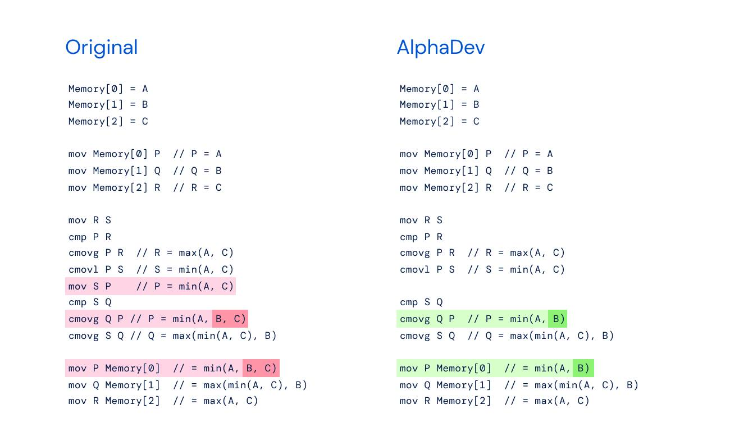

Slide 52
References
Murty, M. N., Devi, V. S.: Pattern Recognition: An Algorithmic Approach (Undergraduate Topics in Computer Science). Springer (2012)
https://www.analyticsvidhya.com/blog/2018/08/k-nearest-neighbor-introduction-regression-python/
https://www.deepmind.com/blog/alphadev-discovers-faster-sorting-algorithms

